Slide 1

7th Grade Math
Unit 13, Lesson 1 Effects of Outliers Volume 2, pg. 233

Slide 2


Benchmark
MA.7.DP.1.1
Determine an appropriate measure of center or measure of variation to summarize numerical data, represented numerically or graphically, taking into consideration the context and any outliers.
volume 2, pg. 233

Slide 3
Integrated Mathematical Thinking and Reasoning Standards
MA.K12.MTR.2.1 Demonstrate understanding by representing problems in multiple ways.
MA.K12.MTR.7.1 Apply mathematics to real-world contexts.
volume 2, pg. 233

Slide 4

Learning Target
I can determine the implications an outlier has in a given data set.
volume 2, pg. 233

Slide 5

Warm-Up
volume 2, pg. 233

Slide 6
13.1.1 Warm-Up: Precision Is Key
Becky Miller is a quality control engineer with GE Aviation. Like many other careers, manufacturing engineering has many moving parts that make up an entire process. Becky says that manufacturing is problem-solving.
List at least two steps that you take when faced with a difficult task.
volume 2, pg. 233

Slide 7
Becky mentions that an error “about the size of a human hair” can make a difference in manufacturing jet engines.
What is a time that you have made a small error that caused a big impact in your next steps?
volume 2, pg. 233

Slide 8

Refresher
volume 2, pg. 234

Slide 9


13.1.2 Refresher: Measures of Center and Variation
Measures of center, such as mean and median, are used to describe a typical value in the data set.
Measures of variation, such as range and interquartile range, are used to describe how “spread out” the data is.
volume 2, pg. 234

Slide 10

Fill in the blanks with the terms provided.
mean range median interquartile range(IQR)
The ___________ is the arithmetic average of a set of numbers. It is a measure of center, or central tendency.
The ___________ is the difference between the highest data value and the lowest data value in a data set. It is a measure of variation.
volume 2, pg. 234

Slide 11
mean range median interquartile range(IQR)
A measure of variation in a set of numerical data, the __________________ is the distance between the first and third quartiles of the data set.
The ___________ is the middle of an ordered list of the values. If the list has an odd number of values, it is the middle value of that list. If the list has an even number of values, it is the average of the two middle values. It is a measure of center, or central tendency.
volume 2, pg. 234

Slide 12
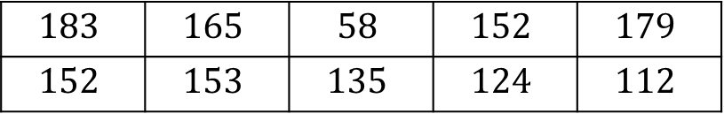
Suppose an office tracks the number of phone calls received on business days, Monday through Friday, over two weeks. The data set is shown below.
Discuss with your partner what you notice about the data set.
$$183$$ | $$165$$ | $$58$$ | $$152$$ | $$179$$
$$152$$ | $$153$$ | $$135$$ | $$124$$ | $$112$$
volume 2, pg. 234

Slide 13
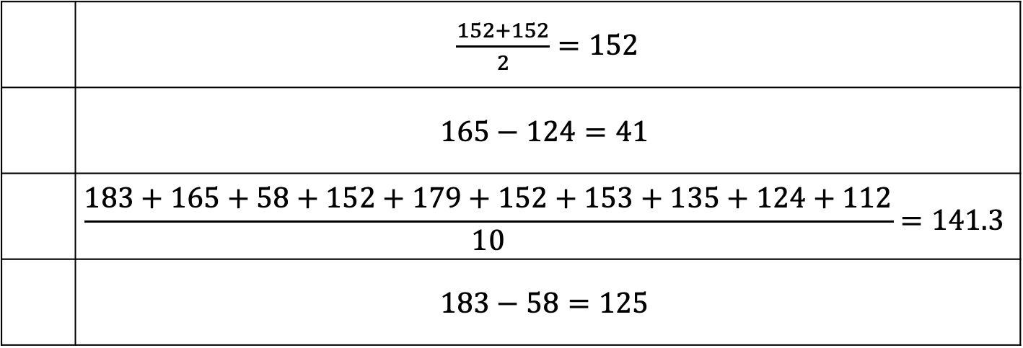
Match the measures of center and variation with their calculations for the data set above.
Mean | Median | Range | IQR
 | $\frac{152+152}{2}=152$
 | $$165−124=41$$
 | $$\frac{183+165+58+152+179+152+153+135+124+112}{10}=141.3$$
 | $$183−58=125$$
volume 2, pg. 234

Slide 14
A histogram, line plot, and box plot representing the data are shown.
Label the display types by filling in the box above each display.
volume 2, pg. 235

Slide 15
Complete the table by identifying which measures of center and variation can be determined from each display.
Are there any data values that are far away from the rest?
 | Mean | Median | Range | IQR
Histogram
Line Plot
Box Plot
An outlier is a value that is much higher or much lower than the other values in a set of data.
volume 2, pg. 235

Slide 16

Guided Instruction
volume 2, pg. 236

Slide 17
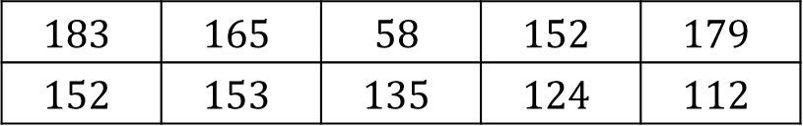
13.1.3 Guided Instruction: Stem-and-Leaf Plots
Recall the data collected on the number of phone calls an office received on business days over two weeks.
In addition to displaying the data graphically with a histogram, line plot, or box plot, the data can also be displayed in a stem-and-leaf plot.
$$183$$ | $$165$$ | $$58$$ | $$152$$ | $$179$$
$$152$$ | $$153$$ | $$135$$ | $$124$$ | $$112$$
A stem-and-leaf plot is a table that organizes data by place value to compare data frequencies.
volume 2, pg. 236

Slide 18
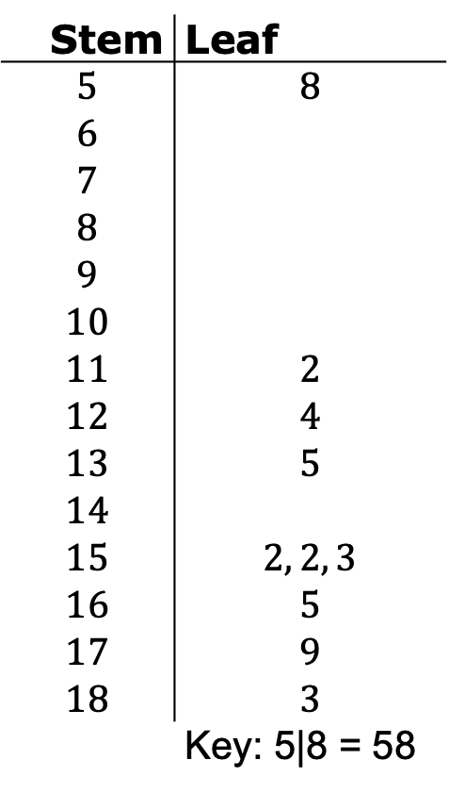
What do you notice about the data in the stem-and-leaf plot?
Stem | Leaf
$$5$$ | $$8$$
$$6$$
$$7$$
$$8$$
$$9$$
$$10$$
$$11$$ | $$2$$
$$12$$ | $$4$$
$$13$$ | $$5$$
$$14$$
$$15$$ | $$2, 2, 3$$
$$16$$ | $$5$$
$$17$$ | $$9$$
$$18$$ | $$3$$
 | Key: 5|8 = 58
volume 2, pg. 236

Slide 19

Compare the stem-and-leaf plot with the line plot from the refresher.
What value does the entry $13|5$ represent?
What similarities do you notice between the displays? | What differences do you notice between the displays?
volume 2, pg. 236

Slide 20
Which measure(s) of center can be determined from the stem-and-leaf plot?
Which measure(s) of variation can be determined from the stem-and-leaf plot?
mean
median
both the mean and median
range
interquartile range
both the range and the interquartile range
volume 2, pg. 236

Slide 21

Collaboration
volume 2, pg. 237

Slide 22

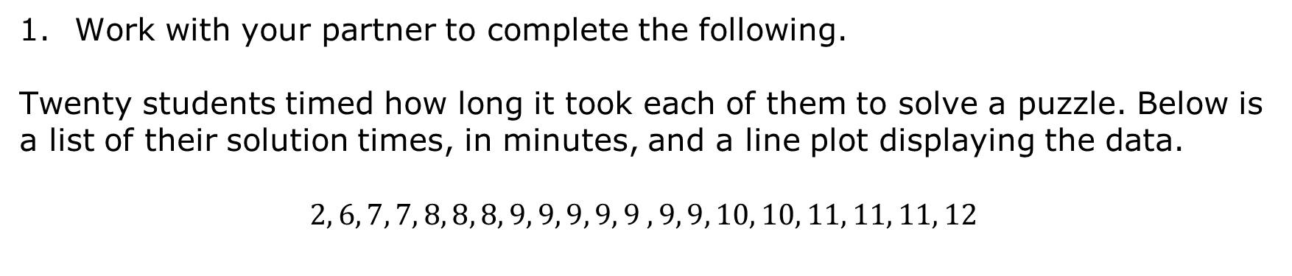
13.1.4 Collaboration: Determining, Describing, and Comparing Numerical Data Represented Graphically
Work with your partner to complete the following.
Twenty students timed how long it took each of them to solve a puzzle. Below is a list of their solution times, in minutes, and a line plot displaying the data.
$$2, 6, 7, 7, 8, 8, 8, 9, 9, 9, 9, 9 ,9, 9, 10, 10, 11, 11, 11, 12$$
Puzzle Solving Time (minutes)
volume 2, pg. 237

Slide 23
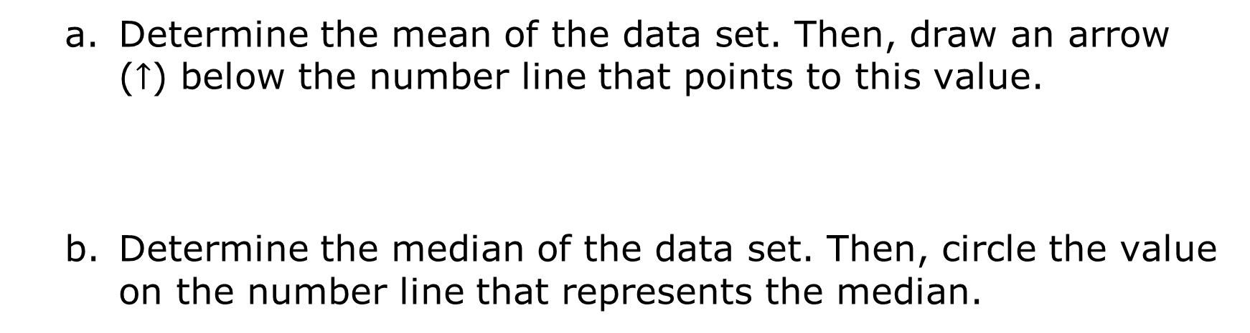
$$2, 6, 7, 7, 8, 8, 8, 9, 9, 9, 9, 9 ,9, 9, 10, 10, 11, 11, 11, 12$$
Puzzle Solving Time (minutes)
Determine the mean of the data set. Then, draw an arrow ($↑$) below the number line that points to this value.
Determine the median of the data set. Then, circle the value on the number line that represents the median.
volume 2, pg. 237

Slide 24
Discuss with your partner what you notice about the mean and the median of the data. Summarize your discussion.
What is the range of the data?
Find the interquartile range (IQR).
Q1 | Q3 | IQR
volume 2, pg. 237

Slide 25
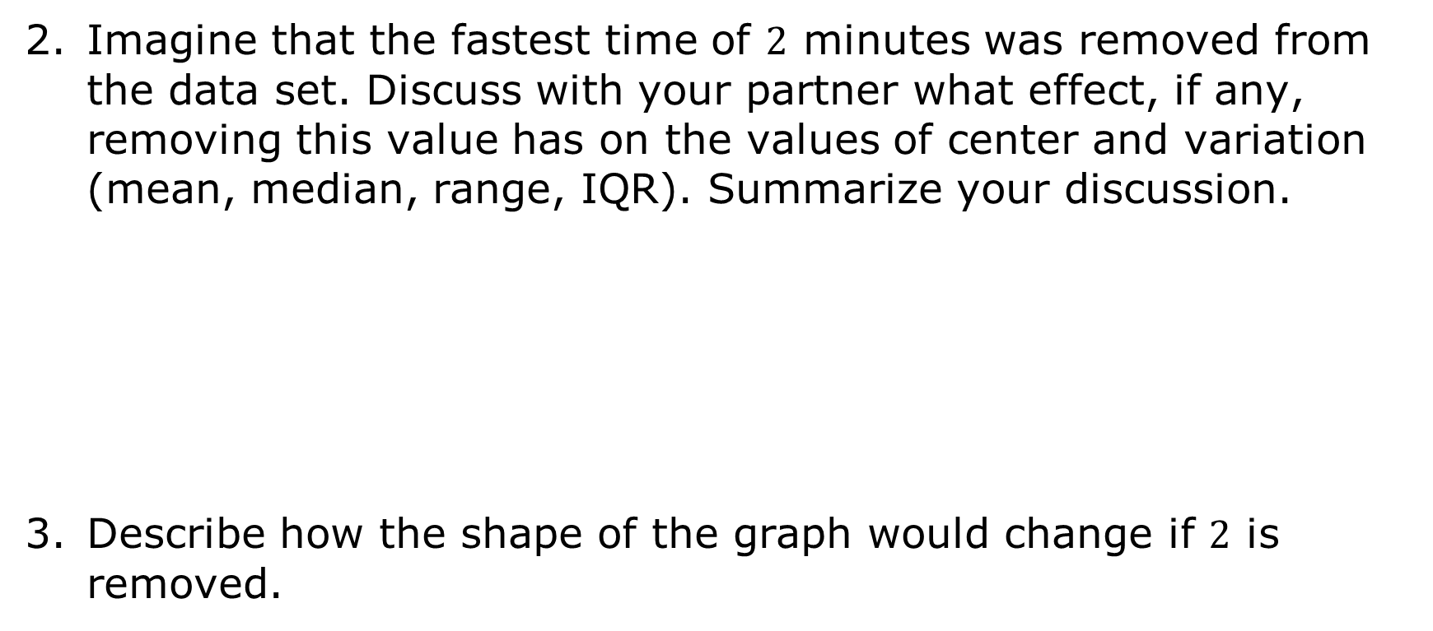
Imagine that the fastest time of $2$ minutes was removed from the data set. Discuss with your partner what effect, if any, removing this value has on the values of center and variation (mean, median, range, IQR). Summarize your discussion.
Describe how the shape of the graph would change if $2$ is removed.
volume 2, pg. 237

Slide 26
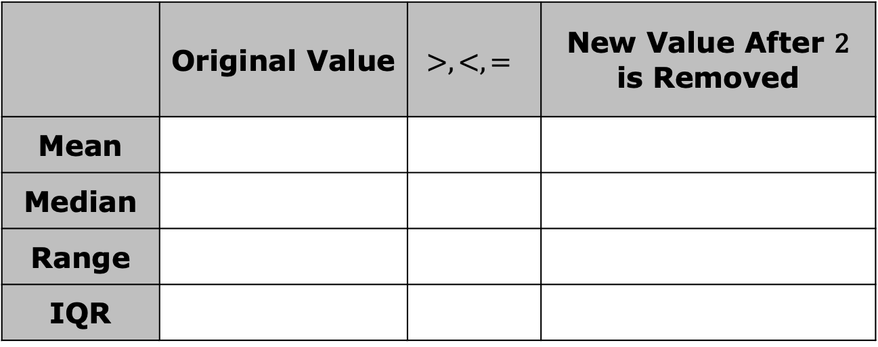
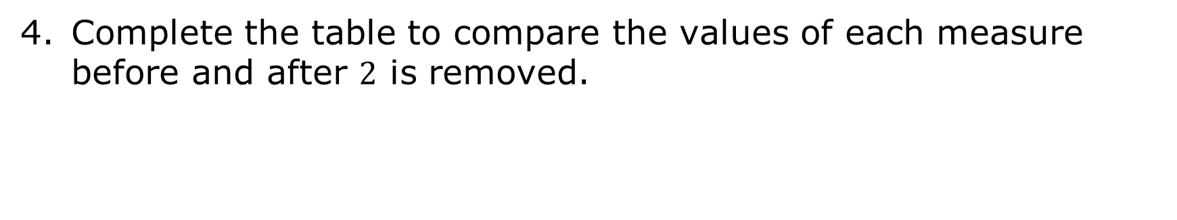
Complete the table to compare the values of each measure before and after $2$ is removed.
 | Original Value | $$>,<,=$$ | New Value After 2 is Removed
Mean
Median
Range
IQR
volume 2, pg. 238

Slide 27
Which measure(s) of center will be affected if the outlier is removed?
Which measure(s) of variation will be affected if the outlier is removed?
mean
median
both the mean and median
range
interquartile range
both the range and the interquartile range
volume 2, pg. 238

Slide 28

Your Turn
volume 2, pg. 238

Slide 29
13.1.5 Your Turn!
The following data set shows the number of tickets a movie theater sold in one day for each movie that is playing at the theater.
One of the values in the data set is an outlier. Explain which value you think is the outlier.
$$162$$ | $$623$$ | $$76$$ | $$277$$ | $$181$$ | $$64$$ | $$105$$
$$265$$ | $$82$$ | $$263$$ | $$124$$ | $$167$$ | $$150$$ | $$245$$
volume 2, pg. 238

Slide 30
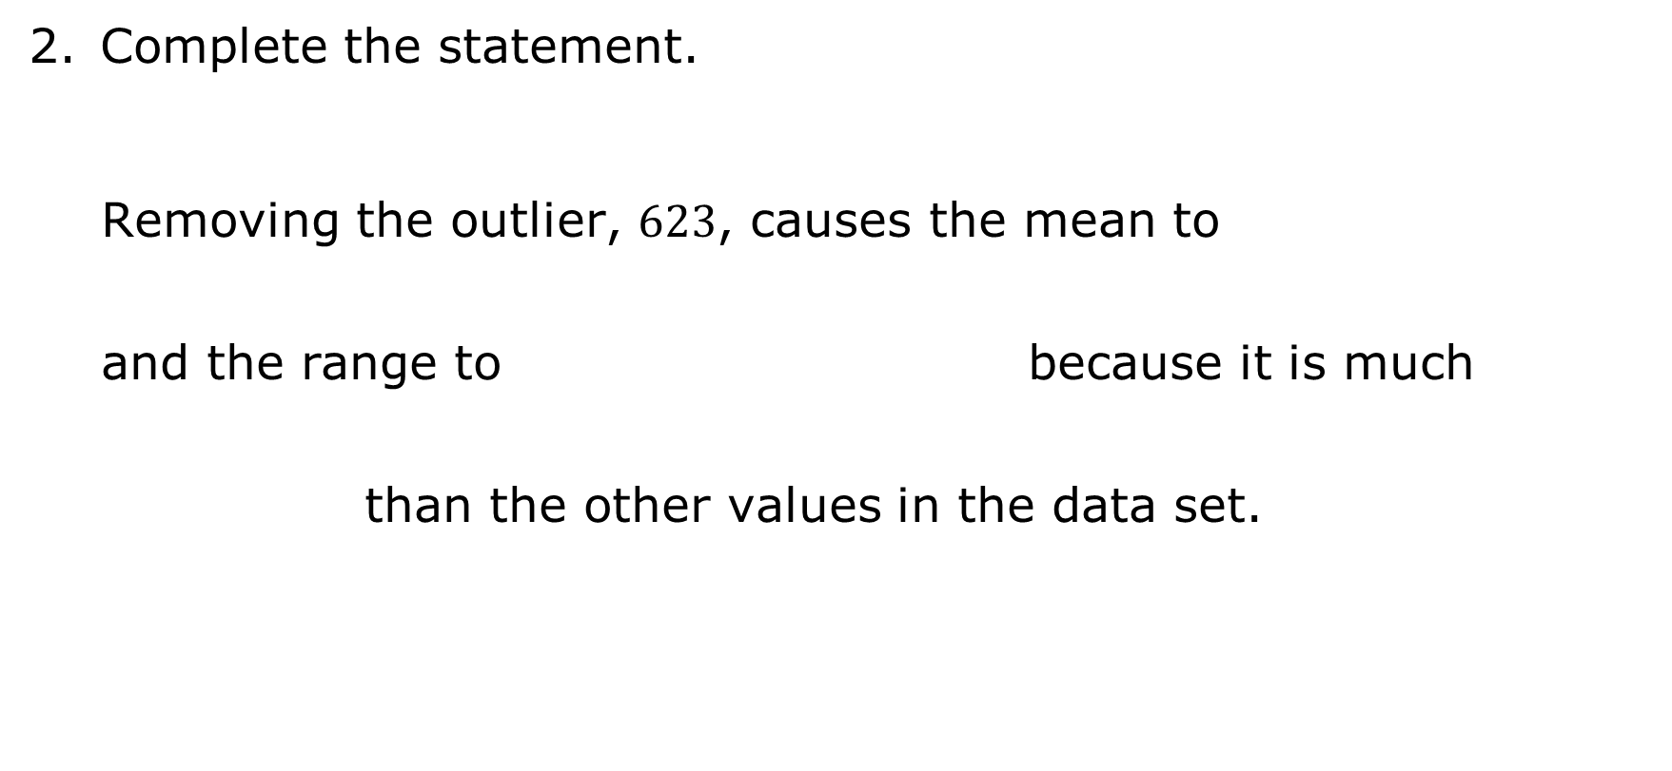
Complete the statement.
Removing the outlier, $623$, causes the mean to and the range to because it is much than the other values in the data set.
increase
decrease
remain the same
increase
decrease
remain the same
larger
smaller
volume 2, pg. 238

Slide 31

Wrap-Up
volume 2, pg. 239

Slide 32






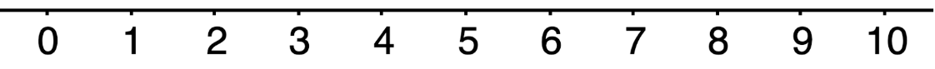
13.1.6 Wrap-Up: Reflection
Rate yourself on today’s learning target using the scale below.
I can determine the implications an outlier has in a given data set.
Write an explanation of why you rated yourself where you did.
volume 2, pg. 239

